Slide 1
$13 Trillion
AI value creation by 2030
Source: McKinsey Global Institute

Slide 2
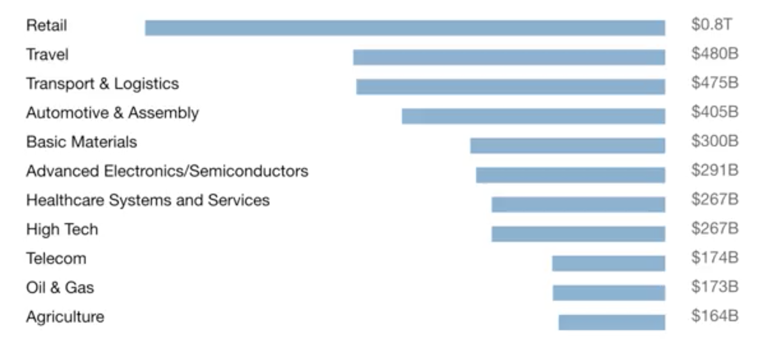
A lot of the value created by AI will be outside the software industry. AI will have a huge impact on all the major industries.

Slide 3
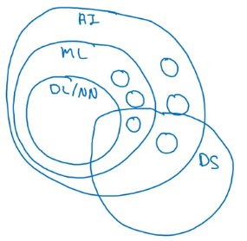
AI and related disciplines
Machine Learning
Data Science
Deep Learning / Neural Network
Supervised Learning
Un supervised learning
Reinforcement Learning

Slide 4
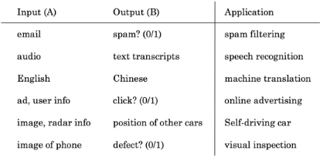
Supervised learning tasks

Slide 5
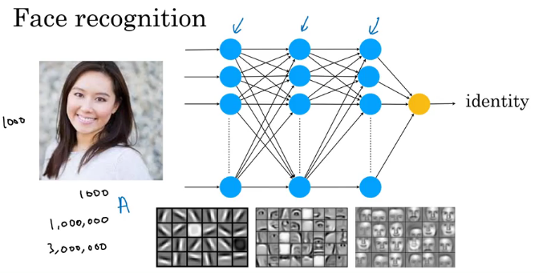

Slide 6
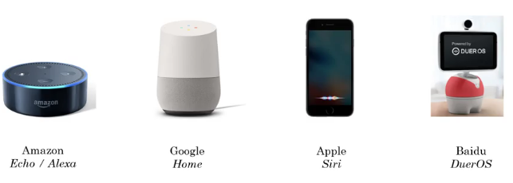
Speech Recognition

Slide 7
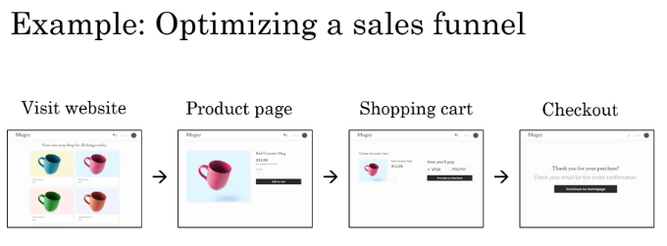
Data Science Project

Slide 8
Machine Learning changing job functions
Sales
    Identifying sales opportunities
    Prioritizing
Manufacturing line manager
    Optimize manufacturing
    Machine learning can spot defects
Recruiting
    Identify how people prefer recruitment
    Spot good candidates

Slide 9
Marketing
      Optimize website
      A/B testing
      Recommendation system
  Agriculture
      What to plant?
      Precision agriculture

Slide 10
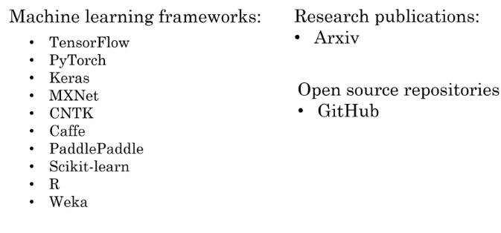
Machine Learning frameworks

Slide 11
AI teams
AI team may have 100s of engineers
A small team can have four or five members
Example roles
      Software Engineers
          Execute joke, Set timer
      Machine Learning Engineer
      Machine Learning Researcher
          Extend state-of-the-art
          Applied ML scientist in between ML researcher and ML Engineer
      Data Scientist
          Provide insights

Slide 12
    Data Engineer
        Organize data
        Data is saved in cost effective way
        We have lot of data, scalability is important
      AI Product Manager
        What to build and feasible

Slide 13
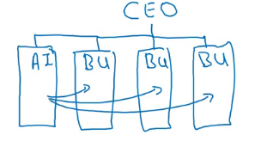
Build an in-house AI team
Develop tools that could be useful company wide
Under CIO, CTO,CDO, CAIO

Slide 14
